Slide 1
BTECH 451
Mid-Semester Seminar idphoto.co.nz
Suzzie Yang
Academic supervisor: Xinfeng Ye

Slide 2
Introduction to idphoto.co.nz
An online servicing platform to obtain standard New Zealand passport photos in either digital form or printable format
Motivation
Taking part in website development as a whole
Gain valuable skill set
Notes:
Idphoto.co.nz is an online servicing platform to obtain standard new Zealand passport photos in either digital form or printable format for paper applications.
The motivation for me to undertake this project is because
website development is a field that I am interested in
this project offers me to be able to achieve a better understand the development as a whole ranging from front-end and back-end design and how the different aspects/components makes a website unique to its functionalities.

Slide 3
Main service flow
Customer view
Choose application type (online/paper)
Select photo form (digital/print out)
Upload photo
Register/sign in
Payment
Order placed
Processing view
Download photo
Check photo validity
Make into passport photo
Upload to customer account]
Order complete

Slide 4
The previous design
All information and service was delivered in one page
Service placement flow from a user point of view was not consistent
Lack of design aspect
Animations
Transitions
Notes:
Idphoto.co.nz was previously developed by another development team which their design concept is having the user to navigate in one page

Slide 5

The previous design

Slide 6
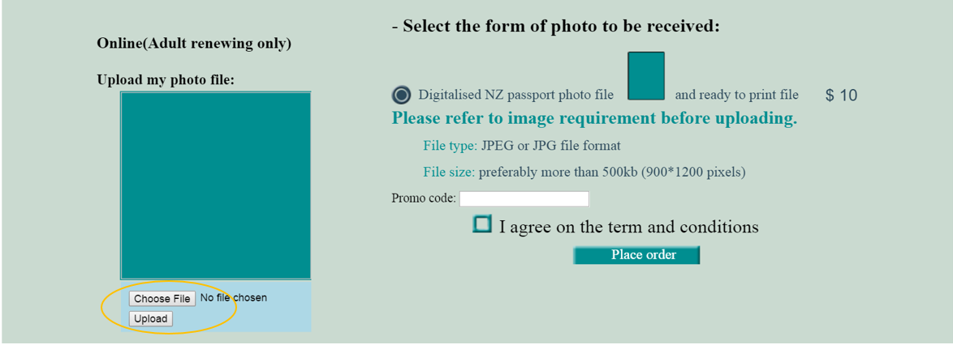
The previous design (2)

Slide 7
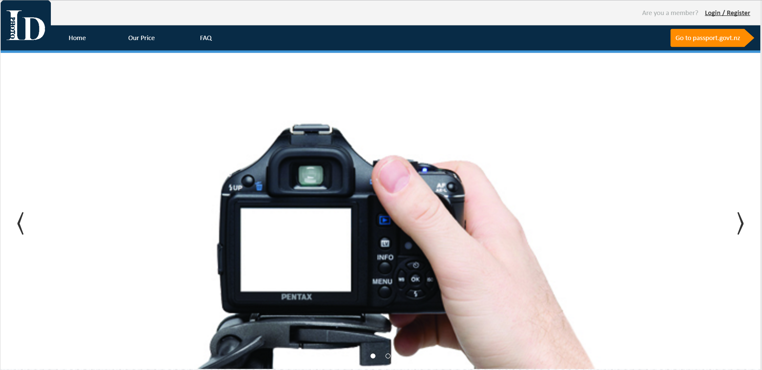
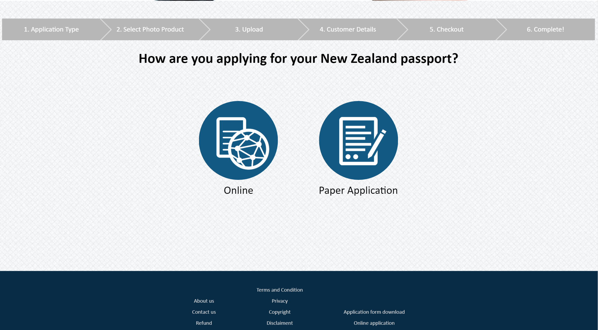
Current design
Live Demo
Notes:
-

Slide 8
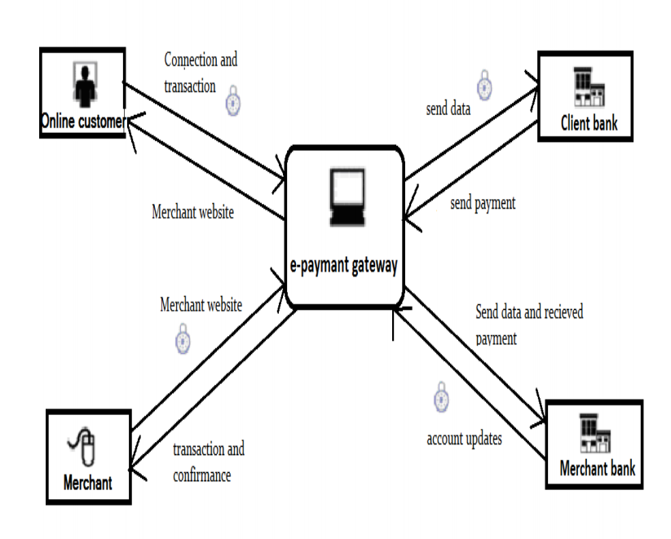
Payment system
Payment gateway
Connects the 4 interfaces together
Provides speed and reliability security of all transactions
Complex implementation
Third party API
Charges commission
Re-direct to another site
PayPal, local bank payment system

Slide 9
Testing with backend
XAMPP
PHP development environment
Testing purposes without accessing to the internet
Computer acts as a localhost
Disable security features to make testing easier

Slide 10



Slide 11
Possible functionalities
Current major issues:
Checking of uploaded photo are done manually
Functionalities to implement in the future:
Automatic photo checking system

Slide 12
Automatic photo checker
Cope with increasingly order volumes
Efficient and effective
Passport.govt.nz photo checker
The first step in their online application process
Validates user upload to ICAO standard
Biometric facial recognition technology
Notes:
ICAO-The international Civil Aviation Organisation

Slide 13
Facial recognition technology
The effectiveness depends on
Image quality
Algorithm for identification
Reliable database
Integrate in idphoto.co.nz
Limit image quality
Algorithms: body portions, background plainness
Database: store samples of accepting images to match with
Notes:
Image quality
-better to distinguish between the uploaded photo to verify against a database of standardised photos.
-Algorithm sued to determine the similarities, analyse the relative position, size, shape of the eyes, nose cheekbones and jaw
-database
Bigger the better

Slide 14
Semester 2 plan
Finish implementing front-end design
Integrate back-end
Study security measures and implement
First testing phase
Finalising and going public

Slide 15
Thank you
Questions?

